Slide 1
Weekly Report
skyforce / RSEE4
2010/03/19

Slide 2
Agenda
Progress
  CCTv3
    GammaAdj+Measure Study 3/30~4/2
    Test Bench done
      Desired Gamma
      G ByPass
      T-CON Input
    BitDepthProcessor done
    UI Redesign ~4/2
    手冊撰寫 & 軟體架構 3/30~
  In-Line Gamma Tuning discussing
Problem
  NB Panel Hook Issue
Future Plan
  CCTv3
    Improvement Research 4/5~5/28
      考量r/g、(r/g)‘的低灰階處理方法
      高次多項式描述面板特性
      新Hook效應解決方法
  In-Line Gamma tuning

Slide 3
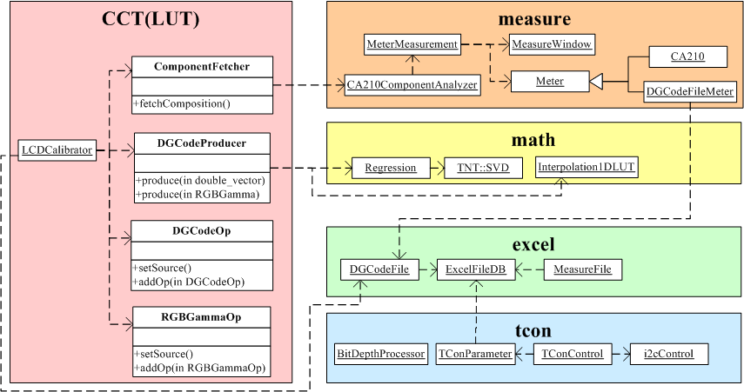
Architecture
New component

Slide 4
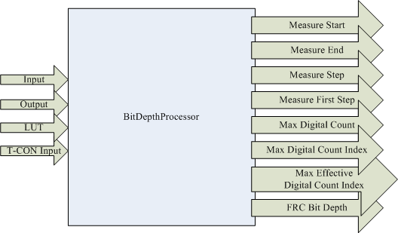
Bit Depth Processor
Bit Depth Processor
  According to T-CON in/out information to determine measure method and DG LUT format.
Input Parameter
  Input: Input bit
  Output: output bit
  LUT: DG LUT bit
  T-CON Input: source by T-CON or PC
Output Parameter
  Measure
    Measure Start: measure start level
    Measure End: measure end level
    Measure Step: measure step level
    Measure First Step: enable for 10-in
  DG LUT
    Max Digital Count: determine on FRC
    Max Digital Count Index: DG LUT cells count
    Max Effective Digital Count Index:
    meaningful DG LUT cells count
    FRC Bit Depth: originally for quantization used, but non-available now

Slide 5
Improvement Research
考量r/g、(r/g)‘的低灰階處理方法
  CA210 Analyzer Mode Function模仿
    產生Green低灰階的Intensity
  Fit目標gamma的G 低灰階DG產生
    使決定亮度比例最大的G貼進目標Gamma
  r/g、(r/g)‘與 色溫變化 & 區域異色 相關性探討
    避免異色的前提下, 進入Spec要求範圍內
新Hook效應解決方法
  高次多項式描述面板特性
    高次多項式描述RGB Intensity與Y關係
    迭代法求多項式解
  調整B Intensity Gain
  調整B DG Lut
  調整R&B Intensity Gain
  調整R&B DG Lut

Slide 6
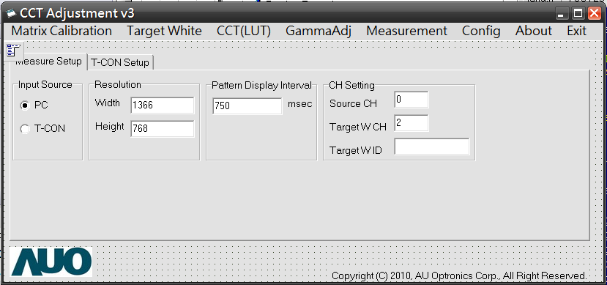
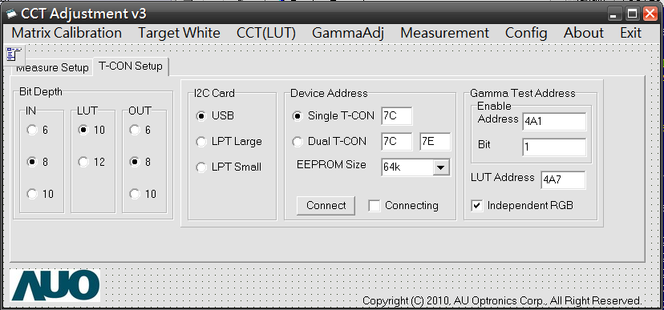
MainForm

Slide 7
 |  |  |  | 2010 Jan |  |  |  | 2010 Feb |  |  |  | 2010 Mar |  |  |  | 2010 Apr |  |  |  | 2010 May
List | Item | Start | End | 1/4 | 1/11 | 1/18 | 1/25 | 2/1 | 2/8 | 2/15 | 2/22 | 3/1 | 3/8 | 3/15 | 3/22 | 4/5 | 4/12 | 4/19 | 4/26 | 5/3 | 5/10 | 5/17 | 5/24
CCT v3.0 Source Code Study | OpenOffice Support | 1/4 | 1/14
 | CA-210 Control @ BCB | 1/11 | 1/15
 | TargetWhite study | 1/18 | 1/28
 | CCT study | 1/29 | 2/24
 | - Raw Data fetch | 1/29 | 2/9
 | - 1D LUT | 2/10 | 2/11
 | - Excel Access | 2/22 | 2/23
 | 低灰階修正 | 2/24 | 3/5
 | - P1P2 Method | 2/24 | 2/25
 | - RB Interp | 2/26 | 3/2
 | - 整合 | 3/3 | 3/5
 | DebugMode | 3/8 | 3/11
 | Test Bench | 3/12 | 3/18
 | I2C Control | 3/19 | 3/29
 | - I2C Study & Class Arrange | 3/19 | 3/24
 | - I2C Implement | 3/25 | 3/29
 | GammaAdj+Measure Study | 3/30 | 4/2
 | - Gray Gamma | 3/30 | 3/31
 | - RGB Gamma | 4/1 | 4/2
 | gammalut實作 | 4/5 | 4/8
 | - TCON 參數整理&介面 | 4/5 | 4/5
 | - LUT載檔及載入TCON功能 | 4/6 | 4/8
 | 手冊撰寫 | 4/9 | 4/14
 | 新增加功能 | 4/15 | 5/28
 | - 考量r/g、(r/g)'的低灰階處理方法 | 4/15 | 5/14
 | - 新Hook效應解決方法 | 5/17 | 5/28
 | 手冊改寫 | 5/31 | 6/1

